Slide 1


Vision-based carbon footprint estimator for smart cities
SAVEETHA INSTITUTE OF MEDICAL AND TECHNICAL SCIENCE
DSA0216-COMPUTER VISION WITH OPEN CV FOR MODERN AI
Presented by: Guided by:
Abinesh H (192424387) dr. senthilvadivu s
b harish Balaji (192424386) dr. kumaragurubaran t
loganath m (192424399)

Slide 2
aBSTRACT
This project presents a Vision-Based Carbon Footprint Estimator designed for smart cities to monitor and manage vehicular emissions. Using computer vision and deep learning, the system detects and classifies vehicles from traffic video feeds and estimates CO₂ emissions based on standard emission factors.

Slide 3
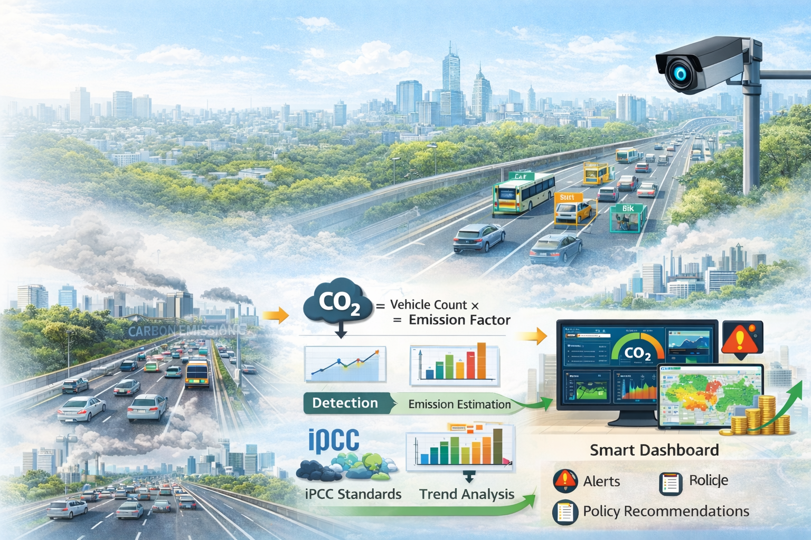
INTRODUCTION
Transportation is a major source of urban CO₂ emissions
Traditional monitoring methods are costly and limited
Smart cities require real-time environmental analytics
Computer vision enables automated traffic analysis
Ai-based systems improve accuracy and scalability
Proposed system integrates traffic detection and emission prediction
Provides decision support for urban authoritie

Slide 4
Objective
To develop a vision-based system for real-time traffic monitoring
To detect and classify vehicles using deep learning techniques
To accurately count vehicles and analyze traffic density
To estimate carbon emissions based on vehicle categories and standard emission factors
To design a predictive model for forecasting future emission trends
To develop an interactive dashboard for real-time visualization of traffic and emission data

Slide 5
LITERATURE REVIEW
Author / year | Title / Source | Key Contribution | Relevance to Current Project | Limitations / Gaps
Redmon et al. (2023) | YOLO: You Only Look Once – Real-Time Object Detection | Introduced a real-time object detection system capable of detecting multiple objects in a single frame with high speed. | Forms the foundation for vehicle detection in Module 1 using YOLO-based models. | Early versions had lower accuracy for small objects and dense traffic scenes.
Bochkovskiy et al. (2022) | YOLOv4: Optimal Speed and Accuracy of Object Detection | Improved detection accuracy and speed using CSPDarknet architecture. | Supports accurate vehicle classification and real-time traffic monitoring. | Requires GPU for optimal performance; limited environmental context awareness.
Ma et al. (2024) | Traffic Flow Prediction Using Deep Learning | Applied LSTM networks for traffic density and flow prediction. | Supports emission forecasting and time-series prediction in Module 2. | Focuses only on traffic prediction, not environmental impact estimation.
IPCC (2024) | Climate Change 2021: Mitigation of Climate Change | Provided standardized emission factors and carbon accounting methodologies. | Provides emission factors used in carbon estimation calculations in Module 2. | Generalized emission factors may not reflect real-time local variations.
Zhang et al. (2022) | Urban Carbon Emission Estimation Based on Traffic Monitoring | Proposed a model combining traffic data and emission factors for urban carbon estimation. | Directly aligns with the vision-based carbon footprint estimation framework. | Limited real-time dashboarding and decision support integration.

Slide 6
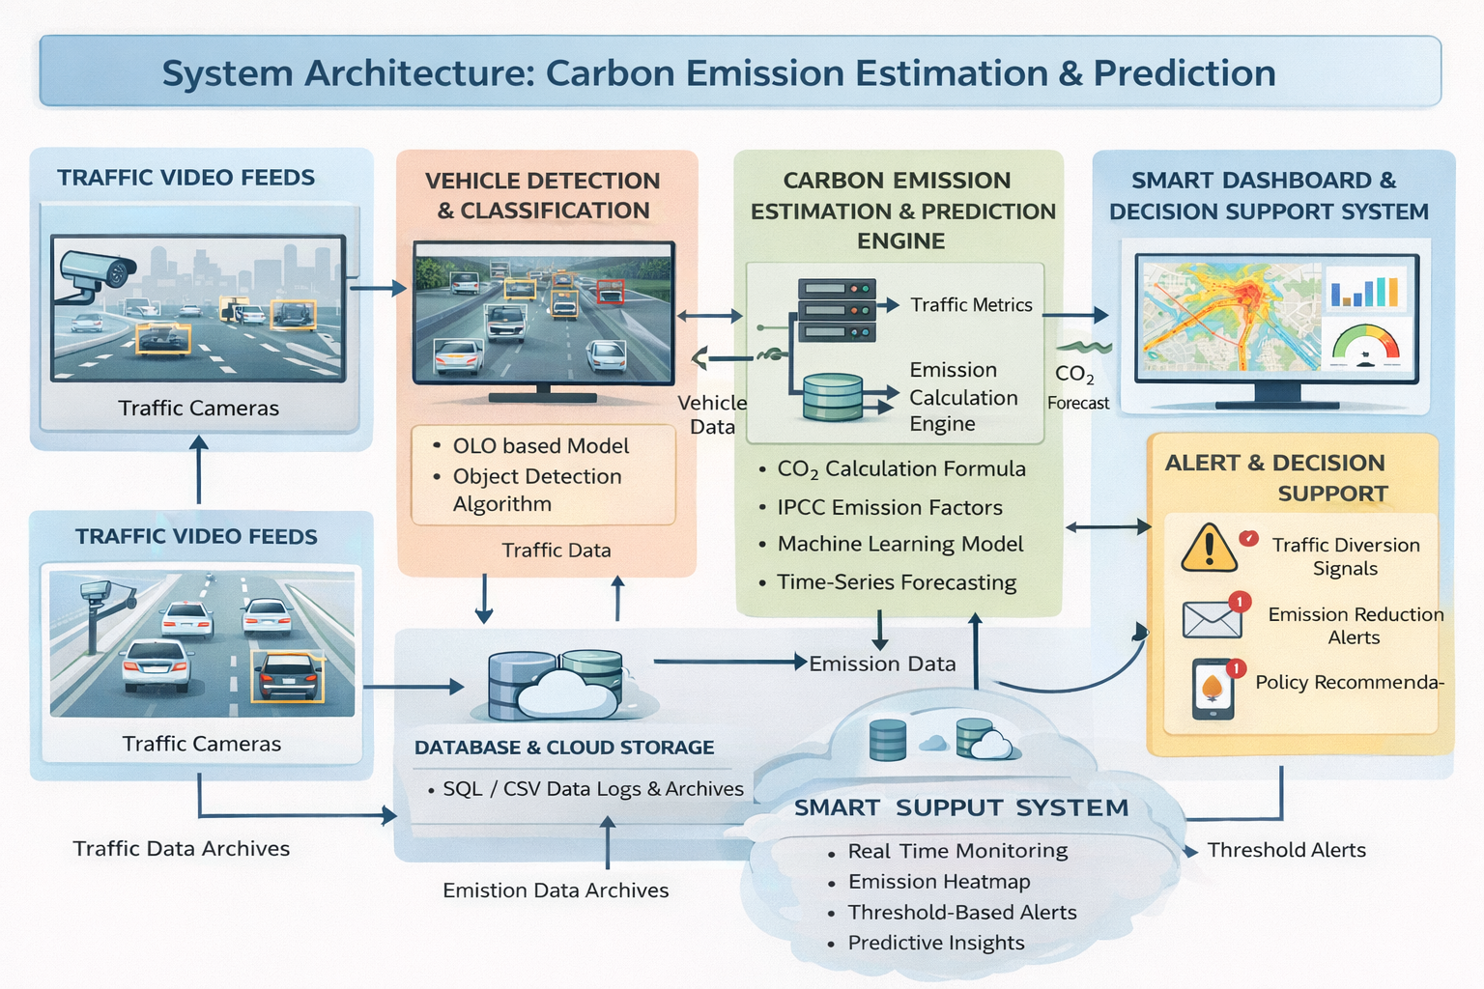
ARCHITECTURE DIAGRAM

Slide 7
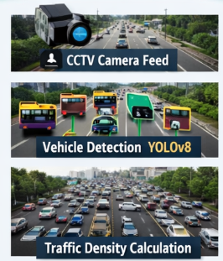
MODULE 1: Vision-Based Traffic Analysis Engine
Purpose
To capture and analyze real-time traffic video streams and to detect and classify different vehicle types
To measure traffic density and vehicle flow rate and to generate structured traffic data for emission estimation
To provide accurate and automated traffic monitoring
Technologies Used
Opencv – frame extraction, preprocessing, ROI selection
Yolov8 – real-time vehicle detection and classification
SORT / Deepsort – multi-object tracking
Python – core implementation

Slide 8
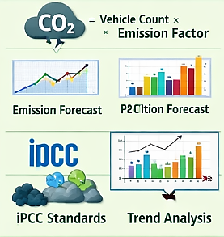
MODULE 2: Carbon Emission Estimation & Prediction Engine
Purpose
To convert vehicle traffic data into carbon emission values and to estimate real-time CO₂ emissions based on vehicle categories
To apply standardized emission factors for accurate calculation and to identify peak pollution periods
Technologies Used
IPCC emission standards – carbon emission factors
Python – emission modelling
Pandas – data aggregation and analysis
Scikit-learn – regression models for emission estimation
LSTM / ARIMA – time-series prediction

Slide 9
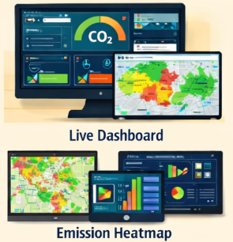
MODULE 3: Smart Dashboarding & Decision Support System
Purpose
To visualize traffic and emission insights and to provide real-time environmental monitoring
To generate alerts when emission exceeds threshold and to assist policymakers in traffic regulation decisions
To enable sustainable smart city planning
Technologies Used
Streamlit / Flask – web dashboard development
Plotly / Matplotlib – interactive charts and graphs
SQL / CSV storage – data logging
REST APIs – data communication between modules

Slide 10
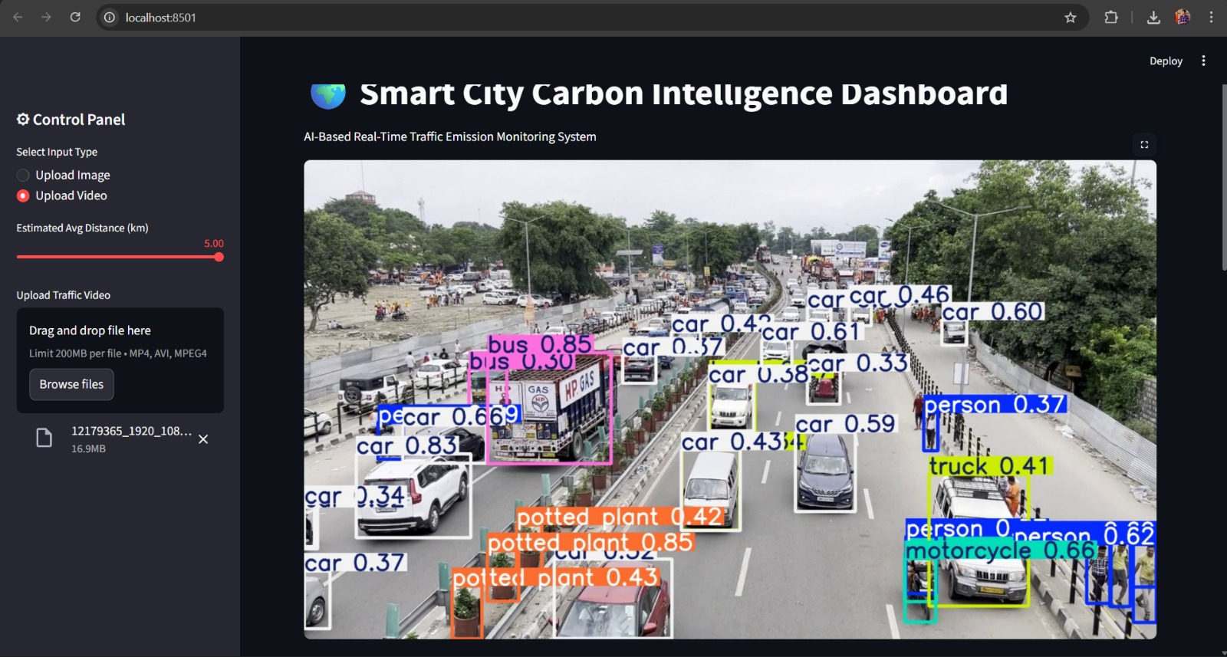
IMPLEMENTATION OUTPUT

Slide 11
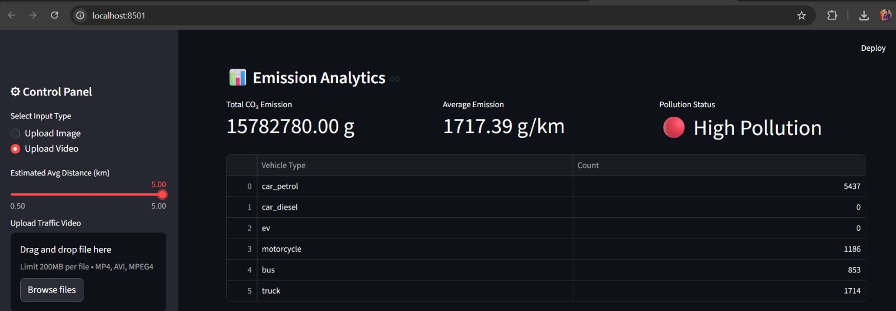
IMPLEMENTATION OUTPUT

Slide 12
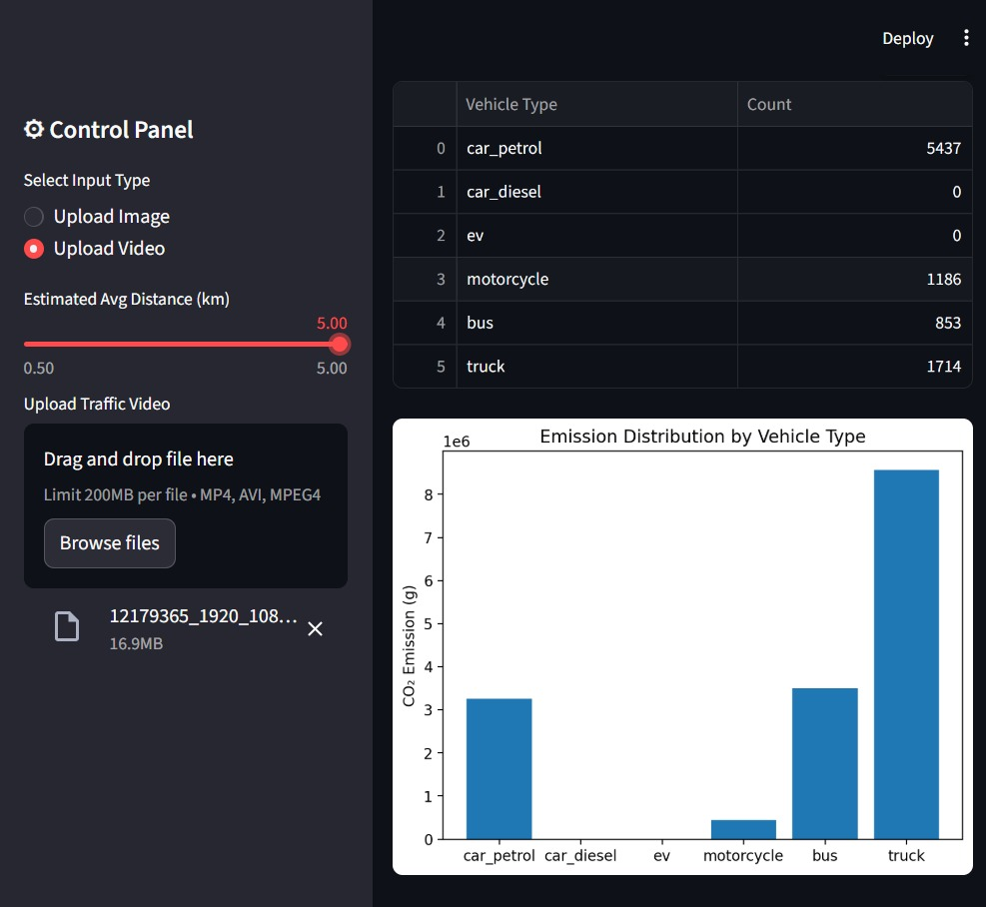
IMPLEMENTATION OUTPUT

Slide 13
Conclusion & future scope
CONCLUSION
Developed a vision-based system for real-time traffic monitoring and carbon emission estimation
Successfully integrated vehicle detection, emission modeling, and predictive analytics
Converted traffic density into measurable CO₂ emission values
Enabled real-time visualization through an interactive smart dashboard
FUTURE SCOPE
Integration with live AQI and IoT-based air quality sensors
Multi-camera city-wide deployment for large-scale monitoring
Inclusion of fuel-type and electric vehicle detection
AI-based traffic signal optimization to reduce emissions
Cloud-based data storage and real-time analytics

Slide 14
Thank you

